Slide 1

Steering Committee Meeting
August 17, 2016

Slide 2
Steering Committee Members
Association | Member | Present? Y/N/Rep
FPI | Bevin Morrissey Aaron Clayton Rebecca McFarland Bob Hoffman
AgCountry | Kari Seidel
Farm Credit East | Steve Rickenbacher Ryan Hrobuchak
Farm Credit West | Melissa Gomes
Northwest | Jacob Ruland
Yankee | Kyle Lussier

Slide 3
Agenda
Greetings and Intro
Defined Items
Undefined Items

Slide 4
Already have initial design
2017 IRS Requirements for Real Estate Collateral
29, 39, & 43: Fix the Lien Position / Loan Position for Farm Credit East
42: Calc Change for FCE for Part Purch LT Loans
34: FEMA Hyperlink for flood maps on Buildings Panel

Slide 5
2017 IRS Requirements for Real Estate Collateral
For Tax Year 2016, IRS is requiring the collection of certain pieces of data:
(Box 7) Address of Property Securing Mortgage
(Box 8) Property Address (If Different form Payers’s/Borrower’s Address)
(Box 9) Property Description (If No Address Available), e.g.
Jackson County, MO
AA-BBB-CC-DD-EE-F-GG-HHH

Slide 6
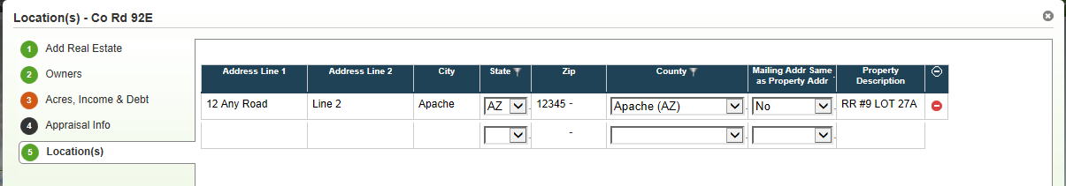
2017 IRS Requirements for Real Estate Collateral
Proposed Enhancement
Add fields to Locations panel:
“Mailing Addr Same as Property Addr” (Yes/No) (will be required)
Property Description
Configure on Address fields for all ACAs
If different mailing address, either address fields OR Property Description is required

Slide 7
Fix the Lien Position / Loan Position for FCE
Two related requests:
Would like lien position to be shut off for FCE. If can't be shut off, shouldn't default to 2 when there are multiple security documents.
I’m not sure why it is a requirement for security documents to be linked to collateral when setting loan position since the security document doesn’t play into the loan position. I understand the need for it when setting lien position but FCE doesn’t use that. We also want the ability to set loan position on the collateral analysis screen (already on the enhancement list) and security documents are not on that screen either which is another reason for security documents to not be a requirement for loan position.

Slide 8
Fix the Lien Position / Loan Position for FCE
Recommended change
We will make whether lien position is considered/displayed a configurable item, to be turned off for ACAs who do not use it. Currently, both FCE and Yankee have requested this ability.
When this configuration is turned off (in other words, lien position is not displayed), then loan position can be manually edited on the Collateral Analysis screen.

Slide 9
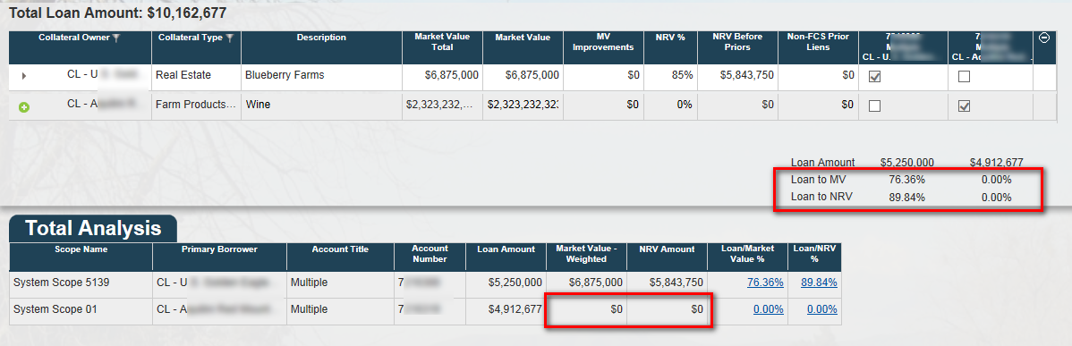
Purchased participations secured by chattel
Currently, if you have a participation loan secured by chattel, the MV and NRV of the chattel are not reflected in the Collateral Analysis screen:
Recommended Change:
The system should perform a behind-the-scenes check on LT loans. If they are participation loans, rather than regular LT loans, than chattel should be allowed as a valid collateral type for securing the loan.

Slide 10
Need analysis and design
1 & 20: Provide a way to insure that any newly calculated LTV ratios based on loan balance changes always get to LOS along with the recalculated LGD
22 & 40: Multiple Scenarios for same system scopes causing issues

Slide 11
Updated LTV/LGD to LOS
Initial Requests:
1 (NW): Refresh Button on Existing Loans : Description: Add a refresh button on existing loans in Collateral Web to allow the program to recalculate the LTV ratio and LGD. Currently, users have to trick the system to trigger a recalc. Users need to change something in a scenario, close and reopen the scenario, then revert whatever was changed to its original state.
20 (AgC): Updated L/V and LGD not flowing to EmPOWER Description: Updated L/V and LGD do not flow to EmPOWER if the loan amount or other fields that affect collateral values do not change in CW. Data must be “dirtied” in CW by modifying collateral amounts, etc. to trick the system into updating values so they can be resubmitted to EmPOWER. We encounter the issue both on actions that require CW (loan origination) and actions that have no collateral impact (reamortization). In both cases, we need accurate L/V and LGD.

Slide 12
Notes from Spreadsheet: ACA opinion of refresh is submit my data after LTV is recalculated, even if appraisal values weren't changed.
Only submit updated LGD if something changed related to calcs.
Originally calculated everything, changed this because required too much work originally to book all actions separately; this has changed, should check this out again.
Suggested solution: Everything that is getting submitted gets an updated LGD. (Example: scenario has 13 loans, but only 3 got changed, so only 3 get updated.)

Slide 13
Updated LTV/LGD to LOS
Stated business need:
Data integrity, internal and external audit issue. PWC did a deep dive into LGD’s a few years ago, and multiple processes were put in place to monitor LGD’s for accuracy. Forcing a user to put in “fake values” to trigger an update creates a significant data integrity issue.

Slide 14
Updated LTV/LGD to LOS
Prior comments (from EPC list):
AgC - This is similar to NW #1 and #2, but need to be sure we’re attempting to solve from the same direction. AgCountry needs L/V and LGD to be current with each credit action; NW may be looking at it from a different direction.
NW - Agreed need to have this one. This is the NW #1 highest priority and impacting our audits and the grades the loans are receiving. In one of our 4 states we've had 25 audit observations that resulted in 13 loans getting a lower grade.
FCW - This item and item #2 and LGD item from AgC are essentially asking for the same thing. FCW agrees, its cumbersome to "dirty" the screen to trigger update LGD to occur. The AgC item is in line with the FCW need to update loans as they are paid down. Let's looks to combine these requests.
FCE - We were not aware of the issue but if it works like explained than agree it is needed and would make sense to force updates to related loans through synchronization action.
YKE - If changes in loan to value and LGD are solely due to amortization, we should be handling this outside of the Collateral App.

Slide 15
What are we trying to solve?
Do we need LTV/LGD to update for all loans in the scope when making a minor update (e.g. text change) in Collateral?
Do we need LTV/LGD to update for all loans for the customer when working on one loan?
Do we need a way to force LTV/LGD to update in LOS because of amortization?
What is audit committee expecting to see that they are not?
Anything else?

Slide 16
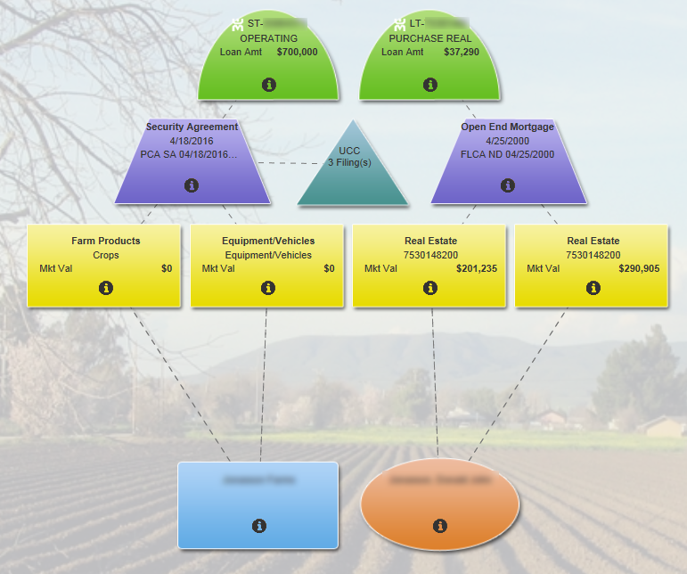
Example – 2 scopes, 2 loans
What do we expect here?

Slide 17
Multiple Scenarios for same system scopes
Initial Requests:
22: Objects “owned” by a scenario not visible to other scenarios Description: Some situations require multiple scenarios for the same customer (branch is working PCA loans while Lending Operations is working on FLCA loans; loans may be booked at different times and be at different stages). User is unable to see which objects are “owned” by which scenario; if they inadvertently make a change in an object “owned” by another scenario, CW locks up, FPI has to script out the scenario and we start over. This typically happens on complex relationships. INC0159065, INC0158903 (AgC)
40: Goal is to reduce the number of multiple collateral scenarios. It is probably infrequent that staff would want to create multiple scenarios for the same group of loans. Would like a warning if possible. It is one of the enhancement discussed in the attached email. (FCE)
Notes:
See prior slide for scope/scenario discussion

Slide 18
Scenarios/system scopes
Stated business need:
We have invested hours trying to trouble-shoot and correct in these situations, resulting in delayed loan closings, time spent at FPI and time spent at AgCountry to recreate the scenario. Staff frustration is high in these situations, we have to take screen prints of multiple objects & panels because we’re not sure which details successfully submitted and are afraid to risk losing any data.

Slide 19
Scenarios/system scopes
Prior comments (from EPC list):
AgC Comments: Similar to FCE "notify users if another scenario exists", but goes beyond a notification because there are times you need multiple scenarios, but the system doesn’t manage the display so you know an object has been “spoken for” in a different scenario
FCW-We felt these pains early on when we first went live. We learned and trained a lot to the SW group on how to always check to see if there are open scenarios, use of the history button to see, which loans are linked to each scenario. I see the need, however feel this is a BIG request and could take a lot of bandwidth. I will say, once our staff did it once, they learned from it and didn’t do it again. Communication is the key between departments.
YKE: Would be nice to have the same Notification used by Credit Pro when another user is also editing the same customer
NW - GMM –This is a really cool idea. Today the recommendation is that if you have actions going that impact different collateral then do separate scenarios. A visual indicator of which objects are separate and can be addressed in a separate scenario would be awesome. Nice to have.
FCE - This is the exact reason FCE would like to see only 1 scenario per system scope and is by far the frustrating thing for staff as it often ends up in a lot of lost time and work. If have multiple loans in different system scopes then OK to have multiple scenarios for same customer as long as the scopes are not in the same collateral scenario. If make changes to loans in different scopes within the same scenario then this should lock staff from creating a new scenario in either system scope.
FCE - As we understand it the multiple scenario option was created to allow staff to : "play in the sandbox" and create different collateral scenarios and then select which one they want to use. Unfortunately staff are finding themselves playing in "quicksand" and before they know it they are in too deep and need help getting pulled back out. This has been by far the biggest hurdle for staff. They don't understand the multiple scenarios and end up creating scenarios that can never be released so they end up losing data and having to start all over. What should happen is the system should not allow multiple scenarios for the same scope of loans that share collateral. An error should pop up if staff do try to create multiple scenarios. This will greatly enhance efficiency, training time and staff frustrations with collateral web.

Slide 20
Scenarios/system scopes
Possible solutions
Ideas go here?
Bob’s suggestion: Don’t allow multiple scenarios to be created, but also don’t lock at the scenario level. Instead, lock at the system scope level so multiple users can work on the same customer at same time, just not on the same system scope.
Our brainstorm ideas?
Questions/issues?

Slide 21
Any additional high priority items?
And can we please default the Search to take us into Collateral???

Slide 22
Backlog list
Do we talk about the backlog? Schedule a different time to discuss? Show them where it is?

Slide 23
Proposed Schedule
Do we want to include that here?

Slide 24

Questions

